Slide 1
Module A.4: Computing History

Slide 2
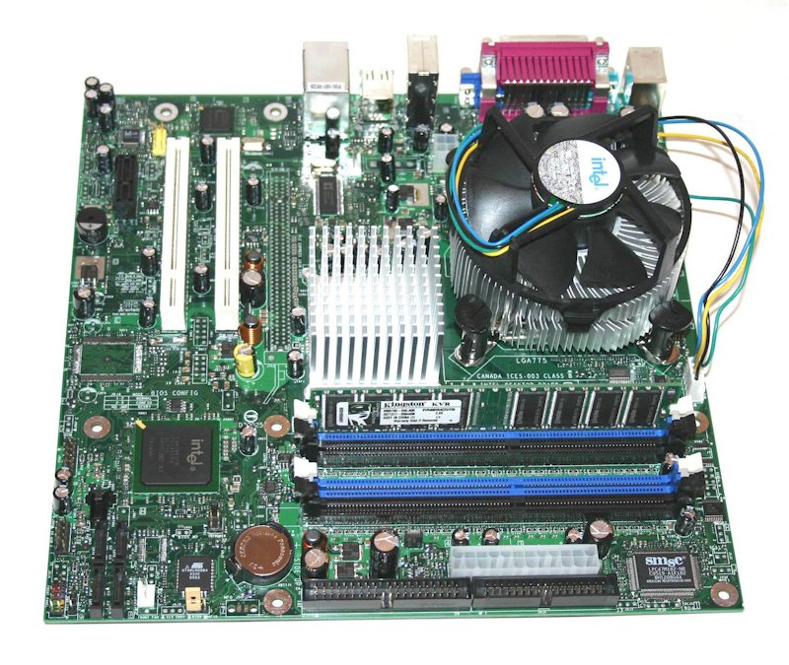
Motherboard
CPU
FAN
CPU

Slide 3
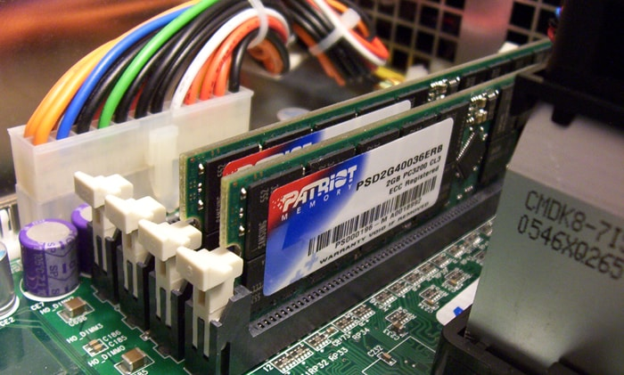
Ram memory
Memory slots

Slide 4
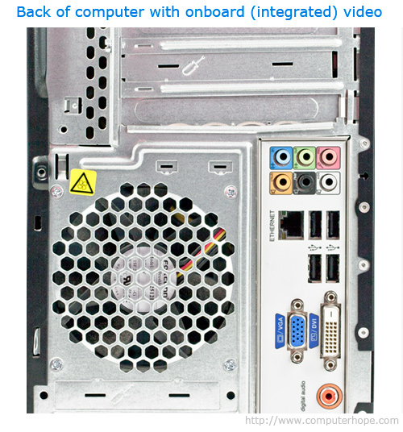
Ethernet cable
Usb
On board video

Slide 5
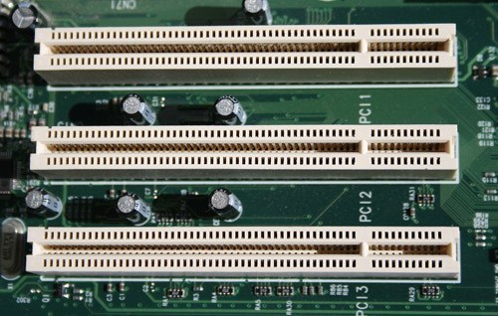
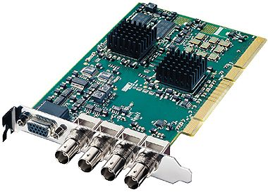
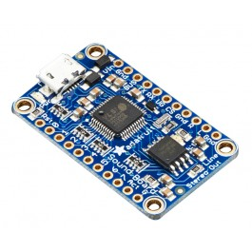
Expansion slot
Sound board
video board

Slide 6
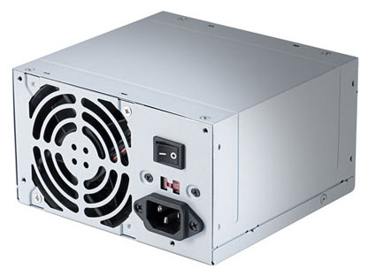
Chassis competent
Power supply
Power Supply

Slide 7
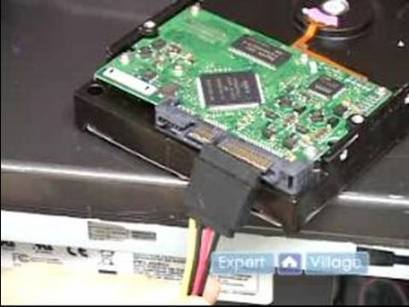
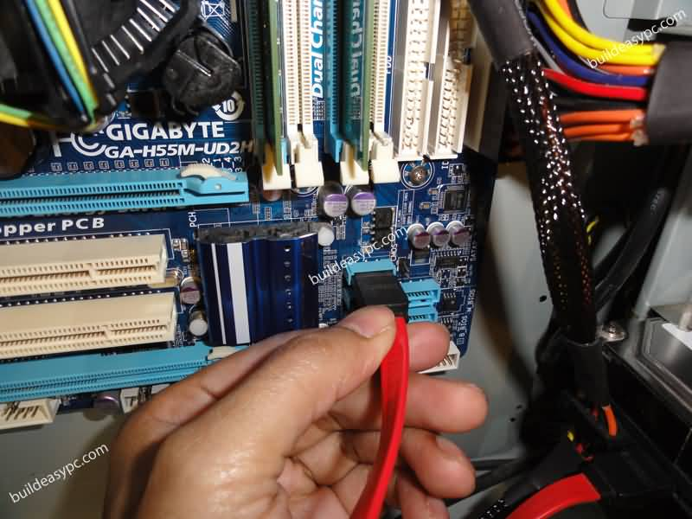
HARDRIVE
Sata cable connected to hardrive
Connection to sata cable

Slide 8
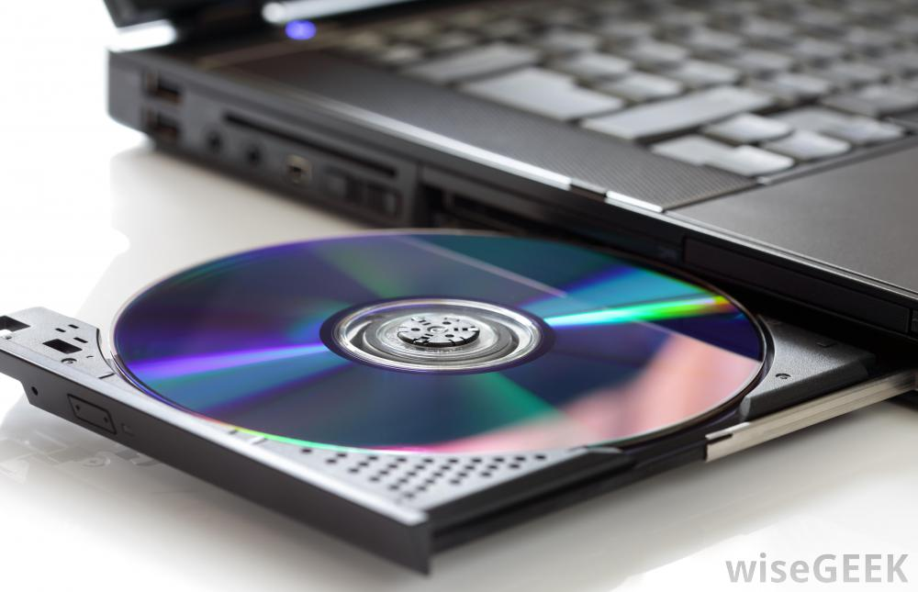
Removable media drives

Slide 9
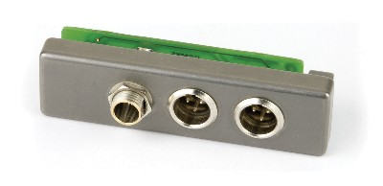
External connector plate

Slide 11
http://www.pro-sound.com/mm5/graphics/00000001/SREXTlg.jpg
http://images.wisegeek.com/disc-in-a-computer-drive-tray.jpg
http://www.pcstats.com/articleimages/200504/hddinstall_satainstall.jpg

